Slide 1

Content and Collaborative based Sinhala Book Recommendation System
Chinthaka Perera
19440677 / 2019/MCS/067
Supervised by:
Prof. M.G.N.A.S. Fernando

Slide 2
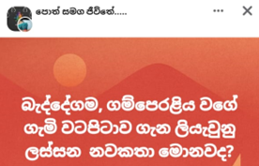


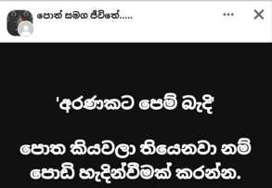
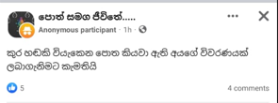
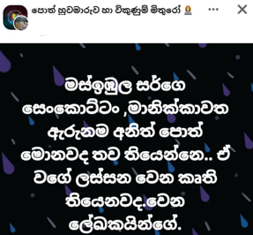
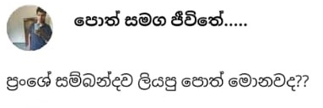



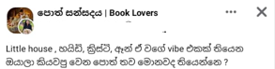
Problem statement

Slide 3
Recommendation systems
Collaboration Based
Content Based
Hybrid

Slide 4
Research gap
Multiple application for English Book Recommendation
Online book store limitations

Slide 5
Scope of the study
Share a Google form
Apply sentiment analysis for the reviews
Login and register to the application
Display a book details when a book is selected
List out recommended book list for the selected book
Recommend books from a selected book list.

Slide 6
Literature works

Slide 7
architecture

Slide 8
challenges
To collect a data set
Implementation
Evaluation

Slide 9
demo

Slide 10
limitations
The books published after 2022 were considered.
Age range has not been considered for recommendation.

Slide 11
Evaluation

Slide 12
Future enhancement
Collect more data to enhance the accuracy.
Display the dropdown book list in Sinhala fonts in data collection form.
Consider latest books.
Include a book purchase facility by routing to an online book store.
Include more filters like genre
Include more details of a book like number of pages, published year, ISBM number

Slide 13
Thank you

